Slide 1
HCBS Settings Updates and Heightened Scrutiny
Provider Association Meeting
February 27, 2017

Slide 2
NYS HCBS Settings Transition Plan Update
NYS submitted the Statewide Transition Plan Version 2 to CMS – January 2017
Available on NYS DOH’s website:
https://www.health.ny.gov/health_care/medicaid/redesign/home_community_based_settings.htm
To date CMS has approved 22 initial plans and only 1 final plan approval (Tennessee)
Notes:
States with Initial Approval: 22
Tennessee
Alaska
Arkansas
Connecticut
Delaware
Hawaii
Idaho
Indiana
Iowa
Kentucky
Montana
New Mexico
North Dakota
Ohio
Oklahoma
Oregon
Pennsylvania
Rhode Island
South Carolina
Virginia
Washington
West Virginia
States with Final Approval: 1
Tennessee
States with an Approved Plan: 1
Tennessee

Slide 3
OPWDD Transition Plan Updates
Family Care Assessment is in Process for State Operated Family Care Homes
Informational Letter Distribution Spring 2017 for Voluntary Operated Family Care Homes:
--30 voluntary providers
--Average of 4 Homes
Notes:
There are 30 FC voluntary provider agencies with a total of 354 homes. The range of homes any provider has under their auspices is 1 - 55.
The average is: 4
The mean is: 7
The mode is: 5
Additional data on number of surveys needing to be completed follows:
· Median number of homes is 7
· Mode is 5 homes
· 18 agencies have 10 or less homes
· 9 agencies have 11—20 homes
· Remaining 3 have 36, 44, and 55
For agencies needing to do validations, the range is 1 – 6.
· 22 agencies will have 1
· 5 will have 2
· 2 will have 4
· 1 will have 6

Slide 4
OPWDD Transition Plan Updates Heightened Scrutiny Evidence and Implementation

Slide 5
Settings that are NOT Home and Community Based 441.301 c 5 of the Regulation
“Home and community based settings do not include the following:
A nursing facility;
An institution for mental diseases;
An intermediate care facility for individuals with intellectual disabilities;
A hospital;
Any other locations that have qualities of an institutional setting, as determined by the Secretary. Any setting that is located in a building that is also a publicly or privately operated facility that provides inpatient institutional treatment, or in a building on the grounds of, or immediately adjacent to, a public institution, or any other setting that has the effect of isolating individuals receiving Medicaid HCBS from the broader community of individuals not receiving Medicaid HCBS will be presumed to be a setting that has the qualities of an institution unless the Secretary determines through heightened scrutiny, based on information presented by the State or other parties, that the setting does not have the qualities of an institution and that the setting does have the qualities of home and community-based settings.”

Slide 6
What is “Heightened Scrutiny”?
Process for submitting evidence to the CMS Secretary for settings that CMS “presumes not to be HCBS” where the state finds that the setting can meet HCBS under a “heightened scrutiny” threshold.
State must overcome the presumption and prove that such settings are not institutional in nature and do not isolate people with disabilities from the broader community.

Slide 7
Heightened Scrutiny Evidence Self-Report—Reminders
Evidence Package was reviewed with Provider Associations during special conference call on 8/5/16
Continuation of information provided in October 2015 through Provider Communication Memo on Heightened Scrutiny
Package is essentially the same as the August 2016 version except for revised timeframe and additional sections added to the Evidence Report requested by DOH

Slide 8
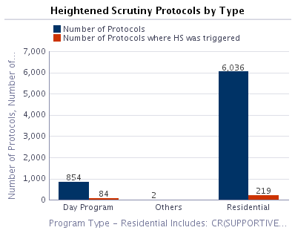
OPWDD--Number of HS Sites Identified by DQI
Notes:
Total of 305 HS sites identified by DQI
How many providers have at least 1 HS setting? 86
Most settings any one provider has? 21
What is the median? 4
What is the average? 3.48
What is the mode? 1
1 setting – 34 providers
2 settings – 20 providers
3 settings – 7 providers
4 settings – 5 providers
5 settings – 5 providers
6 settings – 5 providers
7 settings – 1 provider
9 settings – 2 providers
10 settings – 2 provider (New York Foundling Hospital and Western DDSO)
11 settings – 1 provider (Institute of Applied Human Dynamics)
14 settings – 1 provider (Staten Island DDSO)
19 settings – 1 provider (CNY DDSO)
20 settings – 1 provider (YAI)
21 settings – 1 provider (Finger Lakes DDSO)

Slide 9
How does a provider know if a setting is subject to Heightened Scrutiny ?
If the setting was identified by DQI as subject to HS via Exit Conference Form and/or the agency Director was notified by DQI (10/2015-2/28/2017 review cycle).
Or the provider self-identifies a site as HS by meeting one or more criteria for HS through the Evidence Package Process.
Sites identified as meeting one or more HS criteria by DQI or self-identified will be reconciled by OPWDD and subject to the HS Process.

Slide 10
Reminder--Heightened Scrutiny Process is not one-time
Once OPWDD’s initial HS process is completed, there will need to be a “catch-up” completed to ensure that any ICFs that converted after the evidence due date and any new sites subject to HS and/or newly identified by DQI are processed for HS.
There will need to be an annual HS reconciliation process implemented. Timeframes and processes are TBD.

Slide 11
What Does a Heightened Scrutiny Designation Mean for the Setting and its Provider?
It does not mean that the setting has to close and/or that it can no longer be funded by HCBS. However, the setting must be able to adhere to HCBS regulations to remain a HCBS waiver service.
It does mean the setting is subject to a higher burden of proof that it meets or can meet community standards and is not isolating/institutional.
i.e.: Public Input and CMS Submission of Evidence

Slide 12
Heightened Scrutiny Evidence Self-Report
Evidence Self-Report is completed for all sites subject to Heightened Scrutiny including those identified by DQI.
Questionnaire mostly fill in the blanks—Yes/No; work plan action items provided for check off, as well as “other” category
We are asking for site maps through Google, pictures, and a Work Plan for action items that are not yet in place for full compliance

Slide 13
Example of Evidence Self-Report Question
1) Peoples’ Habilitation Plans are developed and updated using a person centered planning process that reflects their dreams, interests, preferences, strengths, capacities, and informed choices; consequently their Plans drive activities and supports that are meaningful to each person.
Yes
No

Slide 14
If No, Specify Work Plan Action:
1b) Specify the work plan action items.
Check all that apply and attach detailed Work Plan in Section F.
Review and revise service/habilitation plans using a person centered methodology (include description information in Section F)
Train setting staff on person centered planning rights and honoring choices
Train staff responsible for the writing and coordination of service/habilitation plans
Train individuals supported on their rights and how to make informed choices
Reorganize and/or reallocate staffing and or increase resources to ensure sufficient staffing to address people's preferences
Increase access to activities and options that are of interest to people supported
Reorganize and/or reallocate transportation resources to ensure sufficient transportation needs are met
Modification to physical environment
Increase in access to/options for technology (i.e. installation of another phone line, purchase of a computer/cell phone, access to the internet)
Develop and implement strategies to engage natural resources for people supported in the setting
Develop and implement strategies to engage the community for community inclusion options for people supported
Update/Revise policies and procedures applicable to the setting
Other, please specify... ______________________

Slide 15
Revised OPWDD Heightened Scrutiny Process Timeline
DQI Identification of HS Sites (10/2015-2/2017)
Agencies Notified through Exit Conference Forms and Letters
HS Evidence Package Distribution –March 1, 2017
Due date for return is May 5, 2017
May-June 2017
Reconciliation and OPWDD review of Evidence Package for Completeness

Slide 16
OPWDD Heightened Scrutiny Process Timeline (Cont.)
Summer 2017 (Internal OPWDD work)
DQI develops schedule to Front Load HS settings in next Survey Cycle
Complete Packages made available to DQI for validation
October 1, 2017-March 1, 2018
DQI Validates Evidence Packages
April – July 2018
Analysis of packages and OPWDD Decision Making

Slide 17
OPWDD Heightened Scrutiny Process Timeline (Cont.)
August-September 2018
Public Input Process
Fall 2018
Submit Evidence to CMS
October 2018
Full compliance for all OPWDD settings required
MARCH 17, 2019 Full Compliance Required by CMS

Slide 18
Dates and Times for Training
Date of Webinar : Overview of HCBS and HS Questionnaire | Time | Link to Registration
Monday, March 27th, 2017 | 9:30 am – 11:30 am | Event address to register: https://meetny.webex.com/meetny/onstage/g.php?MTID=ec83a6ee091a26d2934a20d810971b81f
Thursday, March 30th, 2017 | 1:00 pm – 3:00 pm | Event address to register: https://meetny.webex.com/meetny/onstage/g.php?MTID=eb78b4732b0f682f828df8779f8cfdd80
Date of Webinar: Q and A HS process | Time | Link to Registration
Monday, April 3rd, 2017 | 1:30 pm – 2:30 pm | Event address to register: https://meetny.webex.com/meetny/onstage/g.php?MTID=e265ab92b0bc75811c3937140c2b58aac
Wednesday, April 5th, 2017 | 2:30 pm – 3:30 pm | Event address to register: https://meetny.webex.com/meetny/onstage/g.php?MTID=e507ce044c0d78e8319a7a0788dbc0c9d
Note: Additional Sessions will be scheduled if needed

Slide 19
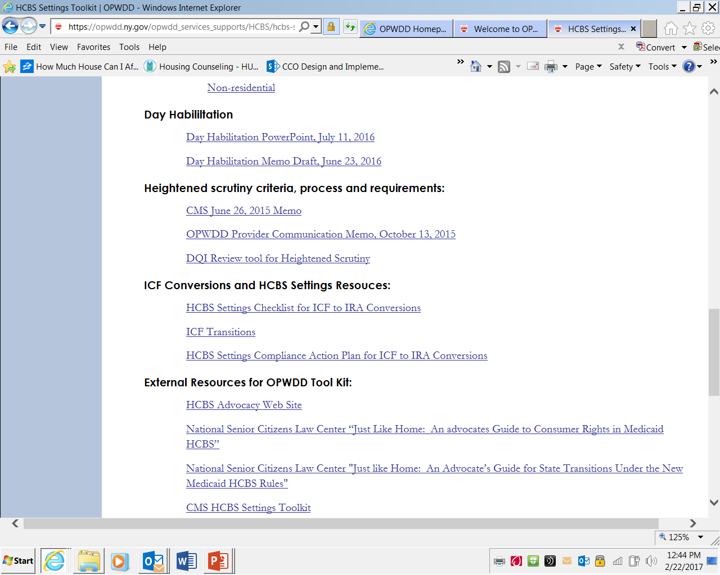
HCBS Settings Toolkit

Slide 20
Questions on HCBS Settings Heightened Scrutiny
Quality@opwdd.ny.gov for DQI site review and heightened scrutiny designations and notifications
Heightened.scrutiny@opwdd.ny.gov
518-486-9863 for Evidence Package questions

